Slide 1
Object-Oriented Programming (OOP)
Lecture No. 2

Slide 2
Abstraction
Abstraction is a way to cope with complexity.
Principle of abstraction:
“Capture only those details about an object that are relevant to current perspective”

Slide 3
Example – Abstraction
Ali is a PhD student and teaches BS students
Attributes
  - Name - Employee ID
  - Student Roll No - Designation
  - Year of Study - Salary
  - CGPA - Age

Slide 4
Example – Abstraction
Ali is a PhD student and teaches BS students
behaviour
  - Study - DevelopExam
  - GiveExam - TakeExam
  - PlaySports - Eat
  - DeliverLecture - Walk

Slide 5
Example – Abstraction
Student’s Perspective
Attributes
  - Name - Employee ID
  - Student Roll No - Designation
  - Year of Study - Salary
  - CGPA - Age

Slide 6
Example – Abstraction
Student’s Perspective
behaviour
  - Study - DevelopExam
  - GiveExam - TakeExam
  - PlaySports - Eat
  - DeliverLecture - Walk

Slide 7
Example – Abstraction
Teacher’s Perspective
Attributes
  - Name - Employee ID
  - Student Roll No - Designation
  - Year of Study - Salary
  - CGPA - Age

Slide 8
Example – Abstraction
Teacher’s Perspective
behaviour
  - Study - DevelopExam
  - GiveExam - TakeExam
  - PlaySports - Eat
  - DeliverLecture - Walk

Slide 9
Example – Abstraction
A cat can be viewed with different perspectives
Ordinary Perspective
  A pet animal with
  Four Legs
  A Tail
  Two Ears
  Sharp Teeth
Surgeon’s Perspective
  A being with
  A Skeleton
  Heart
  Kidney
  Stomach

Slide 10
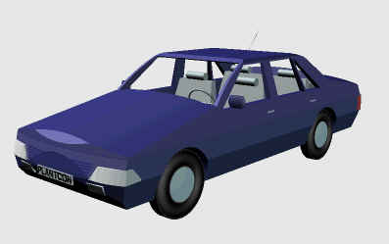
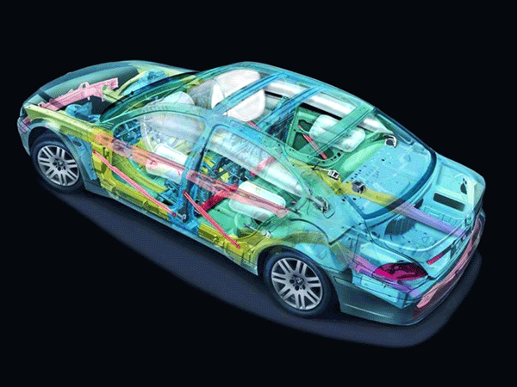
Example – Abstraction
Engineer’s View
Driver’s View

Slide 11
Abstraction – Advantages
Simplifies the model by hiding irrelevant details
Abstraction provides the freedom to defer implementation decisions by avoiding commitment to details

Slide 12
Classes
In an OO model, some of the objects exhibit identical characteristics (information structure and behaviour)
We say that they belong to the same class

Slide 13
Example – Class
Ali studies mathematics
Anam studies physics
Sohail studies chemistry
Each one is a Student
We say these objects are instances of the Student class

Slide 14
Example – Class
Ahsan teaches mathematics
Aamir teaches computer science
Atif teaches physics
Each one is a teacher
We say these objects are instances of the Teacher class

Slide 15
Graphical Representation of Classes
(Class Name)
(Class Name)
(attributes)
(operations)
Suppressed Form
Normal Form

Slide 16
Example – Graphical Representation of Classes
Circle
center
radius
Circle
draw
computeArea
Suppressed Form
Normal Form

Slide 17
Example – Graphical Representation of Classes
Person
name
age
gender
Person
Suppressed Form
eat
walk
Normal Form

Slide 18
Inheritance
A child inherits characteristics of its parents
Besides inherited characteristics, a child may have its own unique characteristics

Slide 19
Inheritance in Classes
If a class B inherits from class A then it contains all the characteristics (information structure and behaviour) of class A
The parent class is called base class and the child class is called derived class
Besides inherited characteristics, derived class may have its own unique characteristics

Slide 20
Example – Inheritance
Person
Student
Doctor
Teacher

Slide 21
Example – Inheritance
Shape
Line
Triangle
Circle

Slide 22
Inheritance – “IS A” or
“IS A KIND OF” Relationship
Each derived class is a special kind of its base class

Slide 23
Example – “IS A” Relationship
Person
name
age
gender
eat
walk
Student
Teacher
Doctor
program
studyYear
designation
salary
designation
salary
study
heldExam
teach
takeExam
checkUp
prescribe

Slide 24
Example – “IS A” Relationship
Shape
color
coord
draw
rotate
setColor
Triangle
Circle
radius
Line
angle
draw
computeArea
length
draw
computeArea
draw

Slide 25
Inheritance – Advantages
Reuse
Less redundancy
Increased maintainability

Slide 26
Reuse with Inheritance
Main purpose of inheritance is reuse
We can easily add new classes by inheriting from existing classes
  Select an existing class closer to the desired functionality
  Create a new class and inherit it from the selected class
  Add to and/or modify the inherited functionality

Slide 27
Example Reuse
Shape
color
coord
draw
rotate
setColor
Triangle
Circle
radius
Line
angle
draw
computeArea
length
draw
computeArea
draw

Slide 28
Example Reuse
Person
name
age
gender
eat
walk
Student
Teacher
Doctor
program
studyYear
designation
salary
designation
salary
study
heldExam
teach
takeExam
checkUp
prescribe

Slide 29
Example Reuse
Person
name
age
gender
eat
walk
Student
Teacher
Doctor
program
studyYear
designation
salary
designation
salary
study
heldExam
teach
takeExam
checkUp
prescribe

Slide 30
Recap – Inheritance
Derived class inherits all the characteristics of the base class
Besides inherited characteristics, derived class may have its own unique characteristics
Major benefit of inheritance is reuse

Slide 31
Concepts Related with Inheritance
Generalization
Subtyping (extension)
Specialization (restriction)

Slide 32
Generalization
In OO models, some classes may have common characteristics
We extract these features into a new class and inherit original classes from this new class
This concept is known as Generalization

Slide 33
Example – Generalization
Line
color
vertices
length
Circle
color
vertices
radius
move
setColor
getLength
Triangle
color
vertices
angle
move
setColor
computeArea
move
setColor
computeArea

Slide 34
Example – Generalization
Shape
color
vertices
move
setColor
Triangle
Circle
radius
Line
angle
computeArea
length
computeArea
getLength

Slide 35
Example – Generalization
Student
name
age
gender
program
studyYear
Teacher
name
age
gender
designation
salary
Doctor
name
age
gender
designation
salary
study
heldExam
eat
walk
teach
takeExam
eat
walk
checkUp
prescribe
eat
walk

Slide 36
Example – Generalization
Person
name
age
gender
eat
walk
Student
Teacher
Doctor
program
studyYear
designation
salary
designation
salary
study
heldExam
teach
takeExam
checkUp
prescribe

Slide 37
Sub-typing & Specialization
We want to add a new class to an existing model
Find an existing class that already implements some of the desired state and behaviour
Inherit the new class from this class and add unique behaviour to the new class

Slide 38
Sub-typing (Extension)
Sub-typing means that derived class is behaviourally compatible with the base class
Behaviourally compatible means that base class can be replaced by the derived class

Slide 39
Example –
Sub-typing (Extension)
Person
name
age
gender
eats
walks
Student
program
studyYear
study
takeExam

Slide 40
Example – Sub-typing (Extension)
Shape
color
vertices
setColor
move
Circle
radius
computeCF
computeArea

Slide 41
Specialization (Restriction)
Specialization means that derived class is behaviourally incompatible with the base class
Behaviourally incompatible means that base class can’t always be replaced by the derived class

Slide 42
Example – Specialization (Restriction)
Person
age : [0..100]
…
setAge( a )
…
age = a
Adult
If age < 18 then
error
else
age = a
age : [18..100]
…
setAge( a )
…

Slide 43
Example – Specialization (Restriction)
IntegerSet
…
add( elem )
…
add element to the set
If elem < 1 then
error
else
  add element to the set
NaturalSet
…
add( elem )
…

Slide 44
Overriding
A class may need to override the default behaviour provided by its base class
Reasons for overriding
  Provide behaviour specific to a derived class
  Extend the default behaviour
  Restrict the default behaviour
  Improve performance

Slide 45
Example – Specific Behaviour
Shape
color
vertices
draw
move
setColor
Triangle
Circle
radius
Line
angle
draw
computeArea
length
draw
computeArea
draw

Slide 46
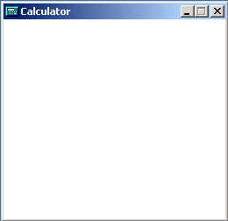
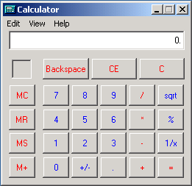
Example – Extension
Window
width
height
open
close
draw
DialogBox
1- Invoke Window’s draw
2- draw the dialog box
controls
enable
draw

Slide 47
Example – Restriction
IntegerSet
…
add( elem )
…
Add element to the set
If elem < 1 then
give error
else
  Add element to the set
NaturalSet
…
add( elem )
…

Slide 48
Example – Improve Performance
Shape
Class Circle overrides rotate operation of class Shape with a Null operation.
color
coord
draw
rotate
setColor
Circle
radius
draw
rotate

Slide 49
Abstract Classes
An abstract class implements an abstract concept
Main purpose is to be inherited by other classes
Can’t be instantiated
Promotes reuse

Slide 50
Example – Abstract Classes
Person
name
age
gender
eat
walk
Student
Doctor
Teacher
Here, Person is an abstract class

Slide 51
Example – Abstract Classes
Vehicle
color
model
accelerate
applyBrakes
Car
Truck
Bus
Here, Vehicle is an abstract class

Slide 52
Concrete Classes
A concrete class implements a concrete concept
Main purpose is to be instantiated
Provides implementation details specific to the domain context

Slide 53
Example – Concrete Classes
Person
Student
Doctor
program
studyYear
Teacher
study
heldExam
Here, Student, Teacher and Doctor are concrete classes

Slide 54
Example – Concrete Classes
Vehicle
Car
Truck
Bus
capacity
load
unload
Here, Car, Bus and Truck are concrete classes

